Slide 1

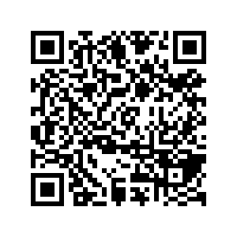
CS1010: Programming Methodology
UNIT 12
Loop Invariant
Live Q&A
https://pollev.com/jin

Slide 2
Unit 12: Loop Invariant
Assertion for Loops
Loop Invariant

Slide 3
Assertion for loops
Problem: Count multiples of 5 between 1 and n-1
1
2
3
4
5
6
7
8
9
10
11
12
13
14
15
long count(long n) {
long y = 0;
long x = n;
while (x > 0) {
// line A
x -= 1;
// line B
if (x % 5 == 0) {
// line C
y += 1;
}
}
// line D
return y;
}
What assertions can be added at line A/B/C/D?
Note that this time round we are annotating an existing program based on its code.

Slide 4
Assertion for loops
Problem: Count multiples of 5 between 1 and n-1
1
2
3
4
5
6
7
8
9
10
11
12
13
14
15
long count(long n) {
long y = 0;
long x = n;
while (x > 0) {
// { (x > 0) && (x <= n) }
x -= 1;
// { (x >= 0) && (x < n) }
if (x % 5 == 0) {
// { (x >= 0) && (x < n) && x is multiple of 5 }
y += 1;
}
}
// { x <= 0 }
return y;
}

Slide 5
Loop Invariant
An assertion that is true before the loop, after each iteration of the loop, and after the loop.
1
2
3
4
5
6
7
8
9
10
11
12
13
14
15
16
long factorial(long n)
{
if (n == 0) { return 1; }
long product = 1;
long i = 1;
// Line A: before the loop
while (i < n) {
// Line B: beginning of each iteration
i += 1;
// Line C: …
product *= i;
// Line D: after each iteration
}
// Line E: after the loop
return product;
}

Slide 6
Loop Invariant
Think in terms of the purpose of the loop
1
2
3
4
5
6
7
8
9
10
11
12
13
14
15
16
long factorial(long n)
{
if (n == 0) { return 1; }
long product = 1;
long i = 1;
// A: { product == i! }
while (i < n) {
// B: { product == i! }
i += 1;
// C: { product == (i-1)! }
product *= i;
// D: { product == i! }
}
// E: { product == i! }
return product;
}

Slide 7
Homework
Post-Lecture Diagnostic Quiz
Problem Set 11/12
Exercise 2
PE preparation

